Slide 1
Mé Fein

Slide 2
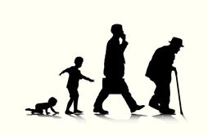
Cén aois thú?

Slide 3
Tá mé aon bhliain déag d’aois. (I am 11 years old)
Tá mé dhá bhliain déag d’aois. (I am 12 years old)
Tá mé trí bliana déag d’aois. ( I am 13 years old)

Slide 4
Cén rang ina bhfuil tú?

Slide 5
Tá mé i rang a sé or next year you could say…
Tá mé sa chéad bhliain

Slide 6
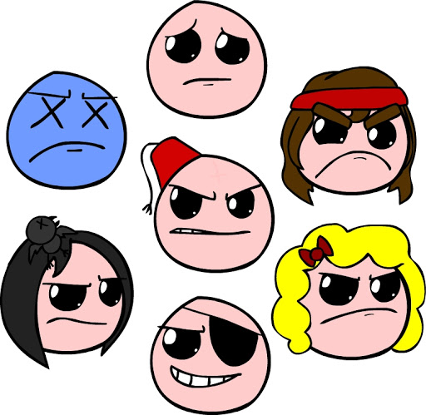
Cén sort duine thú?

Slide 7
Cén sort duine thú? (what kind of person are you?)
Is duine ______mé. (choose 3)
Cainteach (chatty) Cabhrach (helpful) Cliste (clever) Cantalach (irritable)
Mífhoighneach (impatient)
Ciuin (quiet)
Leisciúil (lazy) Cróga (brave)
Greannmhar (funny) Spórtuil (sporty) Cinealta (Kind)

Slide 8
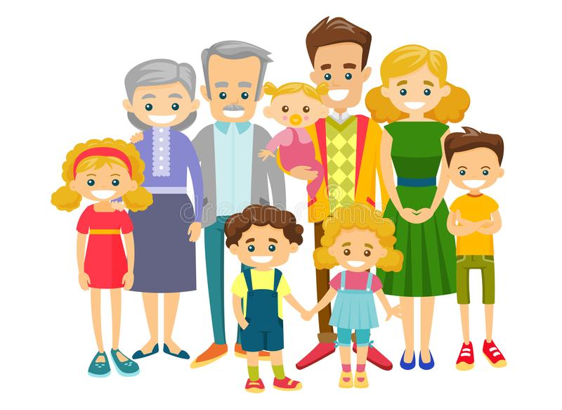
Cé mhéad duine atá i do theaghlach?

Slide 9
Tá beirt i mo theaghlach – There are two in my family
Tá triur i mo theaghlach -There are three in my family Tá ceathrar i mo theaghlach- There are four in my family Tá cuigear i mo theaghlach- There are five in my family Tá seisear i mo theaghlach- There are six in my family Tá seachtar i mo theaghlach – There are seven in my family
Tá ochtar i mo theaghlach – There are eight in my family
Tá naonúr i mo theaghlach –There are nine in my family
Tá deichniúr i mo theaghlach – There are ten in my family

Slide 10
Cad ba mhaith leat a dhéanamh lá éigin?

Slide 11
Cad ba mhaith leat a dhéanamh lá éigin? (what would you like to do one day?)
Bá mhaith liom a bheith i mo _____________ ( I want to be a)
List of jobs found here: https://en.wikibooks.org/wiki/Irish/Vocabulary/Professions
If you’re unsure, try google translate and send it to me to be sure!

Slide 12
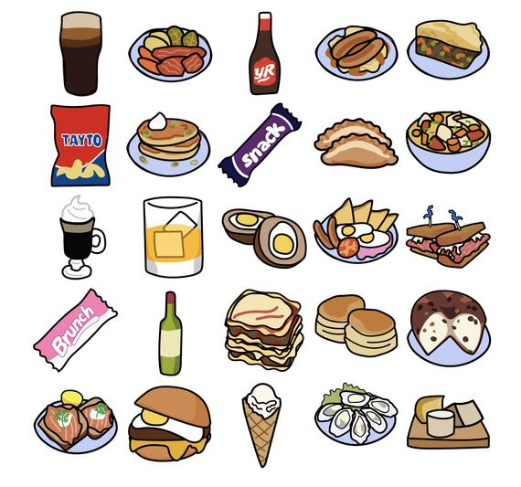
Cad is beile traidisiunta Éireannach ann?

Slide 13
tá go leor cineálacha bia Éireannacha ann, mar shampla
________________________________________
Stobhach – Stew Coddle Bairín Breac
Boxty
pióg an aoire (shepherds pie)

