Slide 1
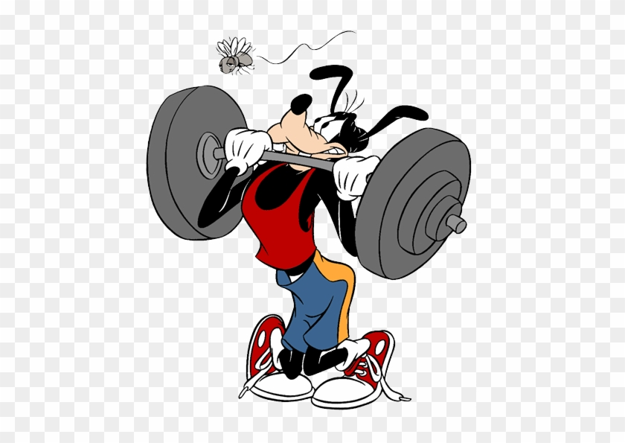
Weight

Slide 2
Mathematical Definition
How hard gravity pulls down on an object.
The weight of an object can change. Where do you think that your gravity might change?
The key word here is gravity…

Slide 3
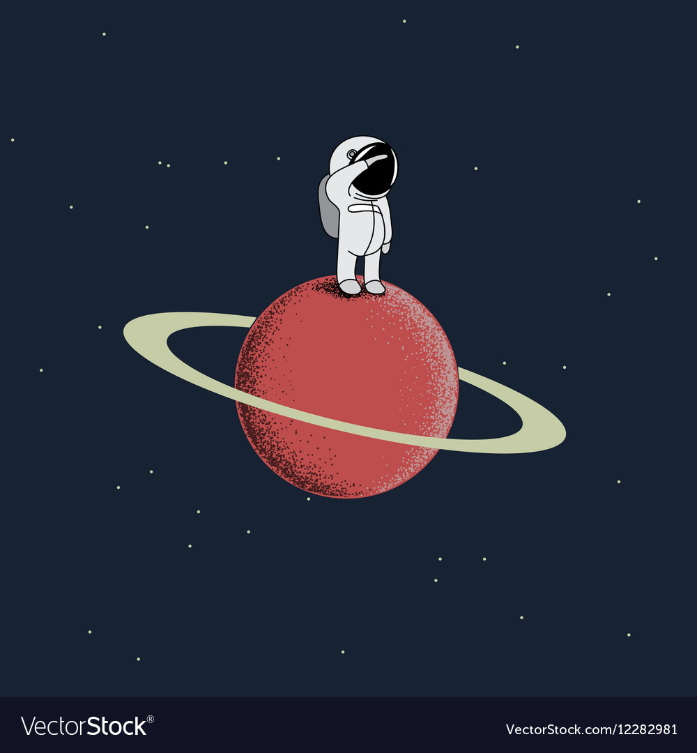
In space
In Space, astronauts would weigh nothing because there’s no gravity pushing down on them. But.. They’re still the same size…still the same shape…
They’ve still eaten all the same food… What’s the word I’m looking for here..?
If you would like to , you can find out about what your weight would be in space here:
https://www.exploratorium.edu/ronh/weight/

Slide 4
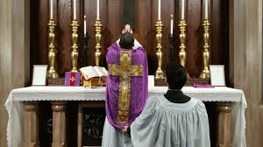
MASS!
But not this type...

Slide 5
Mass
The mass of a body is a measure of how much matter it contains.
The mass of an object will never change.
A bowling ball will have the same mass on earth as in space. The weight of the bowling ball, would be different on the moon than here.
We measure mass in Kg and G.

Slide 6
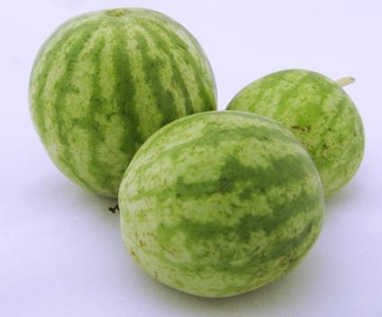
Try these two challenges…
Here are three watermelons.
The one in the front of the picture weighs 7.35kg.
The one on the left of the picture weighs 8.20kg.
The one on the right of the picture weighs 6.45kg.
In a melon-growing competition, a melon is awarded a point for each gram that it weighs.
How many points does each melon gain?
Can you explain how you worked this out?

Slide 7
Pies
Granny had made pies for a bake sale. She had carefully put equal amounts of mixture in each pie tin and was now trying to find the weight of the pies.
She had a problem; she only had one 200 gram weight and one 125 gram weight.
She found that one pie balanced on the scale with both weights and a quarter of a pie.
How heavy was each pie?

